Slide 1


The City that Never Sleeps (too Much Noise)

Slide 2
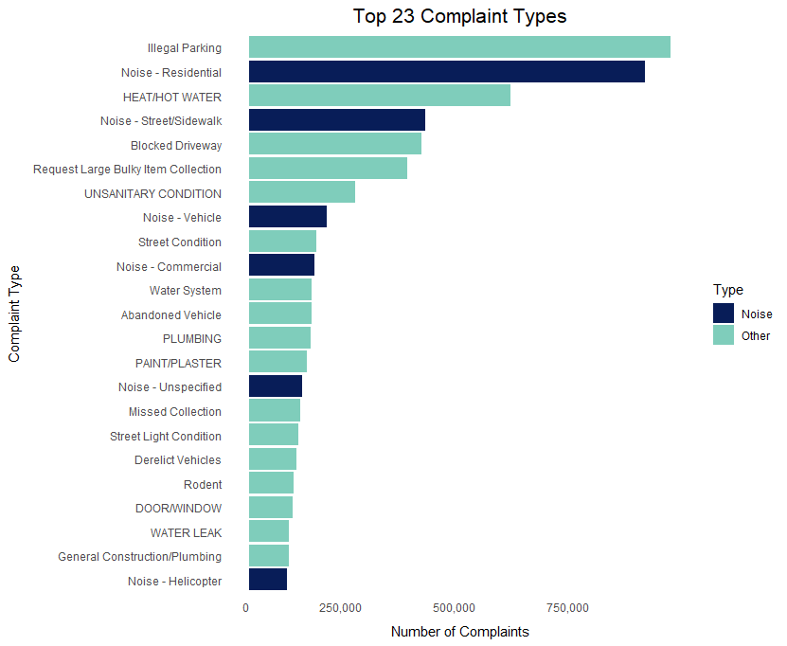
Of the top twenty-three complaints, six are noise related (about 26%).
Top 23 Complaint Types

Slide 3
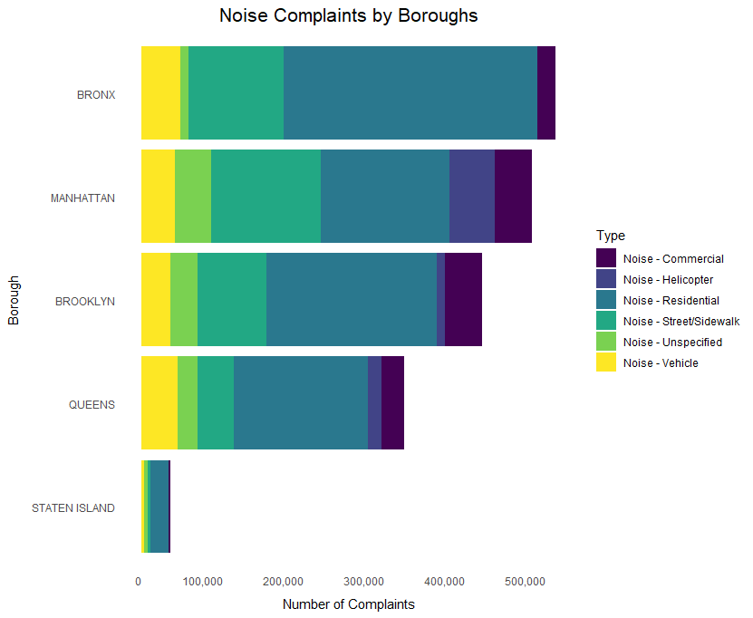
Noise Complaints by Boroughs

Slide 4
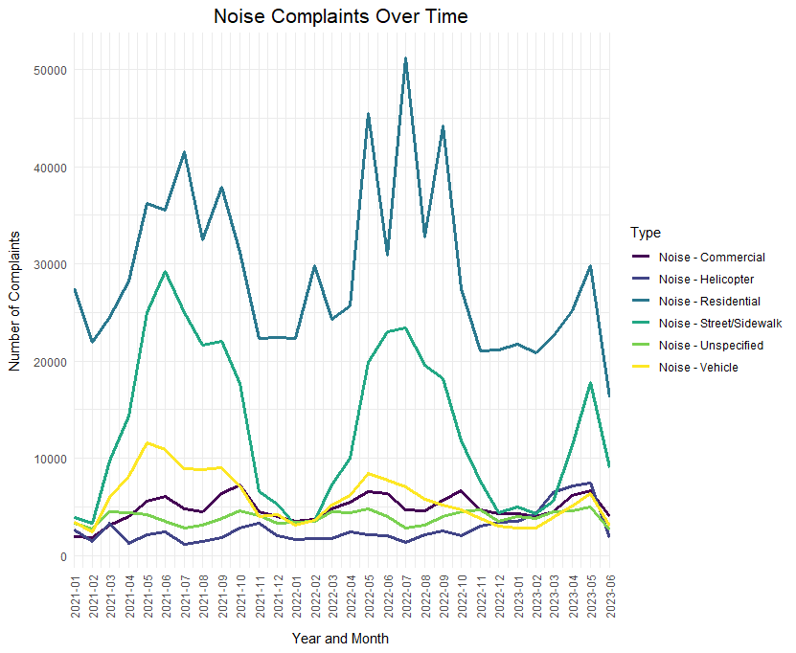
The highest number of complaints occurs between April and September.
Noise Complaints Over Time

Slide 5
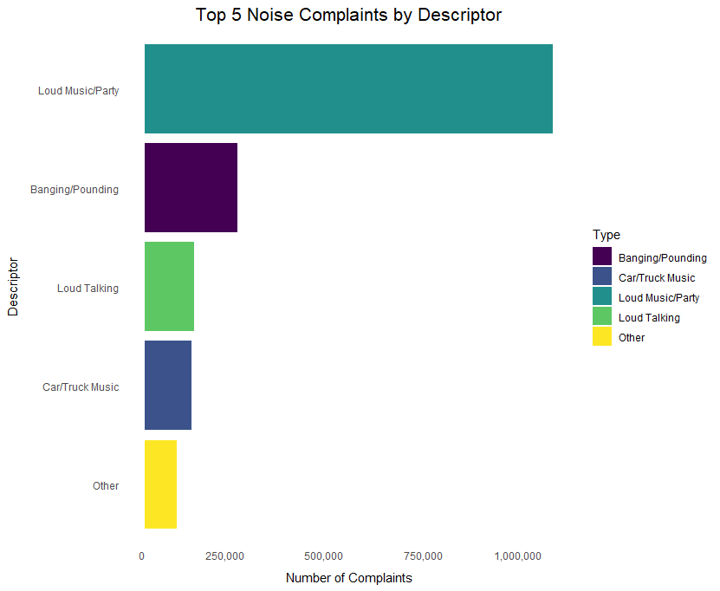
Top 5 Noise Complaints By Descriptor

